Slide 1


INDIAN INSTITUTE OF INFORMATION AND TECHNOLOGY, KALYANI.
NUMBER PLATE RECOGNITION SYSTEM
TOPIC
GROUP: 26
MORA JYOTHISWAR REDDY(576).
2. POSINA PHANI(582).
3. REVELLA BHARATH KUMAR(591).
MENTOR:
DR. AMIT RANJAN AZAD

Slide 2
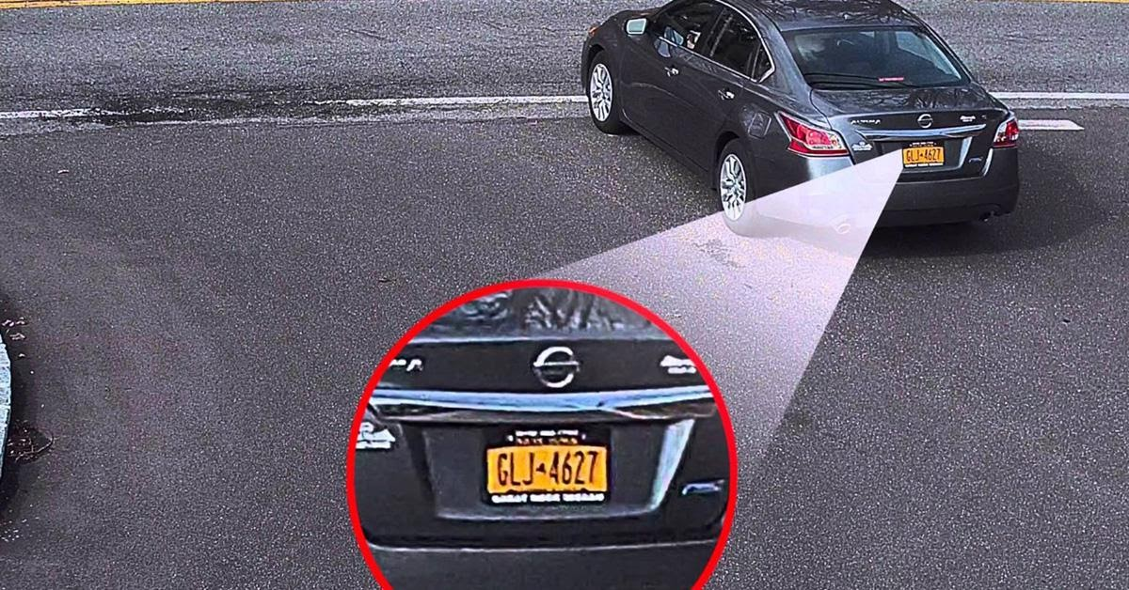
TO RECOGNIZE THE LICENSE PLATE OF THE VEHICLE FROM A VIEDO.
GOAL

Slide 3
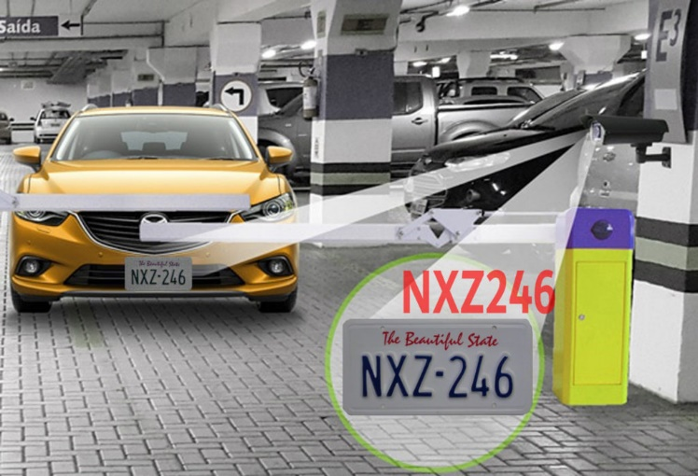
What is ANPR?
ANPR – Automated number plate(license plate) recognition.
Technology that uses optical character recognition (OCR), computer vision, and machine learning techniques to automatically detect, read, and analyze license plate information from images or videos captured by cameras.
ABOUT

Slide 4
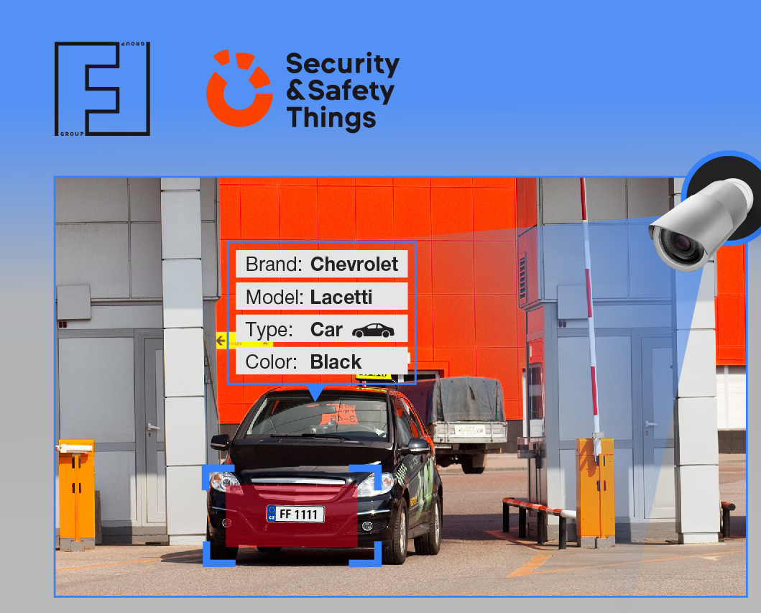
APPLICATIONS:
Law Enforcement
Parking Management
Toll Collection
Border Control
Fleet Management
Application

Slide 5
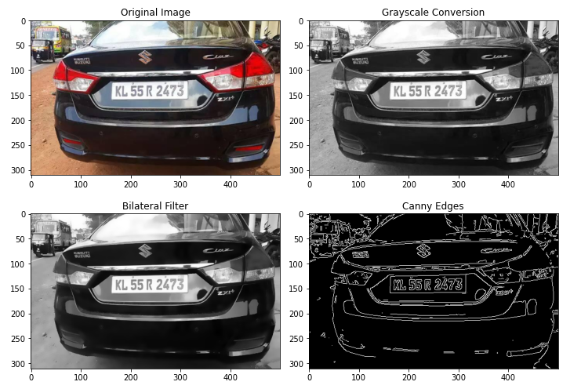
STEPS INVOLVED:
Frame Extraction
Pre-processing of frames
Object Detection
Character Segmentation
Character Recognition
STEPS

Slide 6
Steps Involved:
Frame Extraction – The video is processed frame by frame, and each
frame is extracted from the video.
Pre-processing – Improves image quality, noise reduction
Bilateral filtering – used for noise reduction in the image.
STEPS
Bilateral filtering

Slide 7
Steps Involved:
Object Detection – Identifies the license plate region.
Involves Binarization and Edge detection techniques.
STEPS
Edge Detection

Slide 8
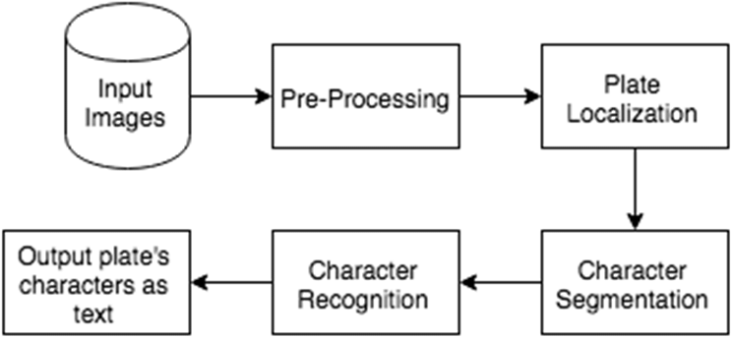
Steps Involved:
Plate Localization - the algorithm may first need to localize the region 0f the video where the plate is most likely to be present .
Tracking - license plate needs to be tracked across multiple frames of the video.
STEPS

Slide 9
Steps Involved:
4. Character Segmentation: - Individual characters on the license plate are
separated.
Involves 2 steps:
Contour Application
Bounding boxes are applied
TOPIC

Slide 10
Steps Involved:
Contours - curve that represents the boundary of an object or region in an image.
1. The license plate is then segmented into individual regions corresponding to each character by analyzing the properties of the contours.
TOPIC
Bounding box - extract individual characters from the license plate.
character candidates are extracted by applying size, aspect ratio, and other constraints.
Each character candidate is classified into a specific character using a character recognition algorithm, such as a convolutional neural network (CNN).

Slide 11
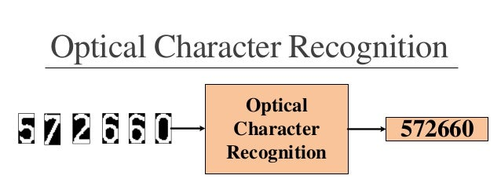
Steps Involved:
Character Recognition – Reads the text in the license plate.
Uses – OCR Technology
OCR – Optical Character Recognition
Python-tesseract & easyocr – OCR tool in python.
STEPS

Slide 12
Number_plate_Cascade
Is a machine learning model that is used to detect license plates within an image.
haarcascade_russian_plate_number.xml – is a pre-trained Haar - cascade for detecting license plates.
This cascade was trained on a large dataset of license plate images and is able to recognize the specific features of license plates, such as their shape, size, and character patterns.
PROCESS

Slide 13
Number_plate_Cascade
Load the input image.
2. Convert the image to grayscale.
Detect license plates.
This function applies the pre-trained Haar cascade to the input image and returns the bounding boxes of the detected license plates.
PROCESS
4. Extract license plate region - character segmentation or recognition.

Slide 14
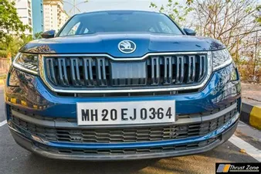
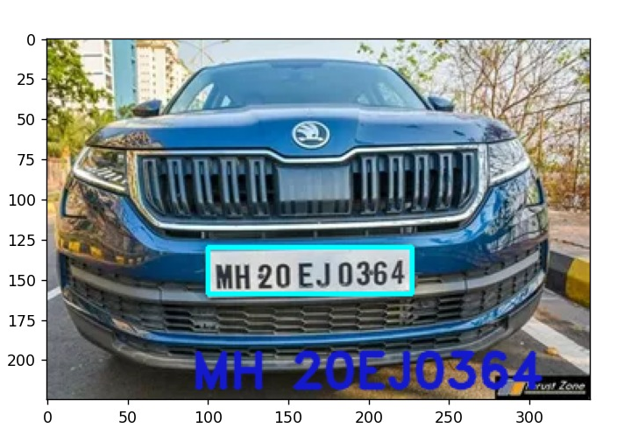
RESULT
Result

Slide 15
THANK YOU..!!
END

